Slide 1
CROP PRODUCTION ANALYSIS

Slide 2
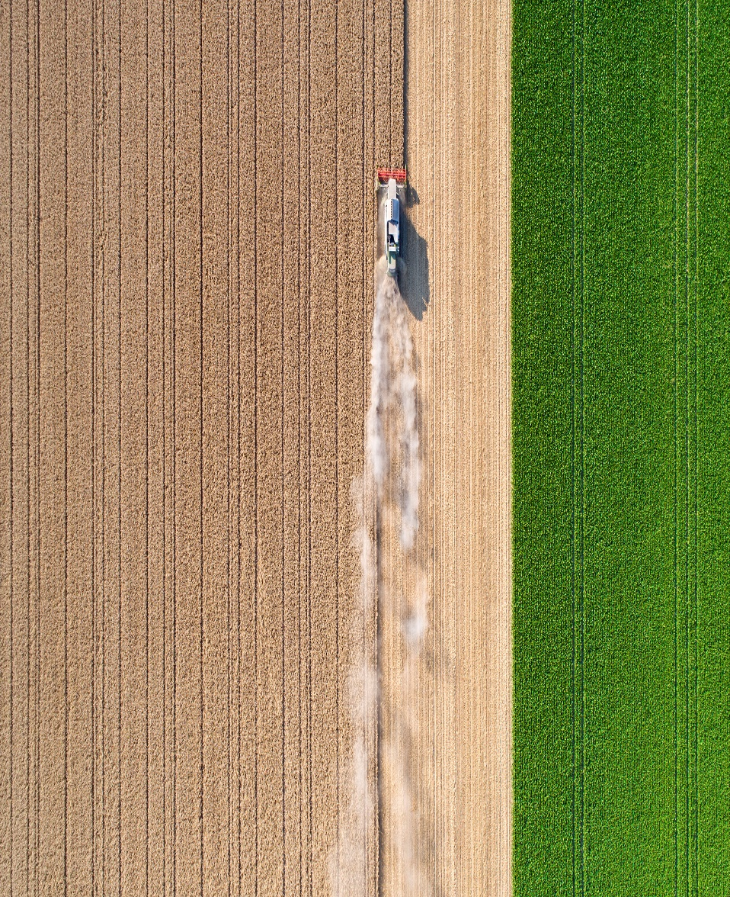
OVERVIEW
Crop Production Analysis aims to understand and optimize agricultural productivity by analyzing various factors such as crop yield, land use, weather conditions. Advancements in technology, such as precision agriculture, drones and data analytics are increasingly being used to enhance crop production efficiency and sustainability.
Balancing the influences is crucial for sustaining and improving crop production to meet the growing global food demand.

Slide 3
PROBLEM STATEMENT
The Agriculture Business Domain as a vital part of the overall supply chain is expected to highly evolve in the upcoming years via the developments, which are taking place on the side of the Future Internet. This presents a novel Business-to-Business collaboration of numerous stakeholders belonging to associated business domains, in an effective and flexible manner. The dataset provides a huge amount of information on crop production in India ranging from several years. Based on the Information the Ultimate Goal would be to predict crop production and find important insights highlighting key indicators and metrics that influence crop production.

Slide 4
INDICATORS INFLUENCING CROP PRODUCTION
Agronomic Indicator
Soil Health
Water Availability
Crop Varieties
Pest and Disease
Economic Indicator
Input Costs
Market Prices
Yield
Environmental Indicator
Climate Conditions
Water Quality
Biodiversity
Technological Indicator
Adaption of Technology
Research and Development
Social Indicator
Farmer Education and Training
Access to Credit
Land Holdings
Infrastructure Development

Slide 5
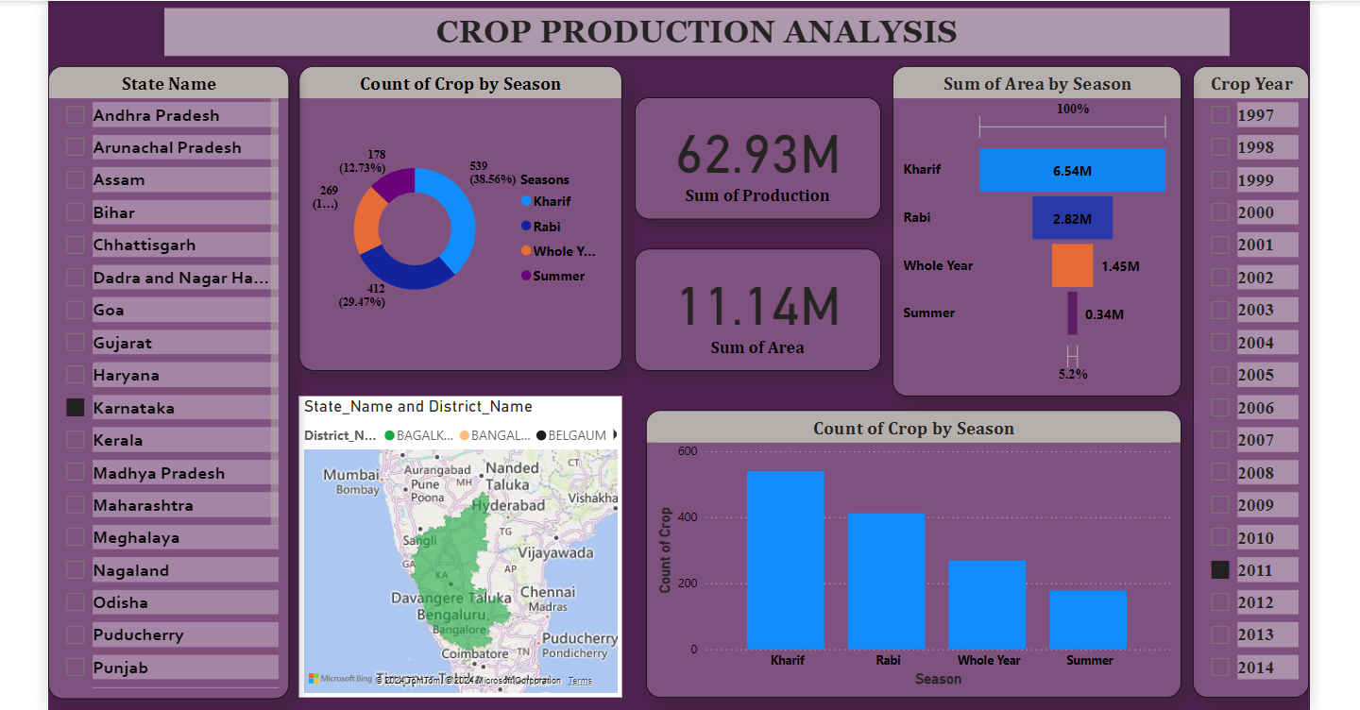

Slide 6
CHALLENGES AND SOLUTIONS

Slide 7
FINANCIAL BURDEN OF HIGH-TECH FARMING
In Karnataka, a farmer who previously relied on organic methods to grow crops embraced modernization and higher yields by adopting precision agriculture technology. This included GPS-guided tractors, automated irrigation systems, and high-yield genetically modified (GM) seeds. Initially, these investments appeared advantageous as they led to a notable increase in crop yield. However, the substantial costs associated with maintaining this technology, along with the expensive chemical inputs required for GM seeds, soon exceeded the benefits. This financial strain escalated, resulting in mounting debt and heightened stress for the farmer.
He turned to agricultural extension services and local farming cooperatives for assistance. Through them, he discovered integrated farming systems that integrated modern technology with organic methods. He transitioned to using organic fertilizers and biopesticides, which were both cost-effective and sustainable. Diversifying his crops naturally improved soil fertility and lessened reliance on chemical inputs. Joining a cooperative enabled him to share the costs of technology with fellow farmers, reducing individual financial burdens. This balanced approach allowed him to sustain high productivity without the strain of excessive costs, leading to a more sustainable and profitable farming approach.

Slide 8
MARKET COMPETITON FROM NON-ORGANIC PRODUCE
The strategy focused on emphasizing the distinctive value of organic produce. This began with educating customers about the health and environmental benefits of organic farming through workshops and farm tours. Utilizing social media platforms, He shared their farming journey, success stories, and the advantages of organic food, reaching a wider audience. Additionally, he formed partnerships with local health-conscious restaurants and organic food stores to secure consistent demand. He also introduced a delivery service, offering fresh, organic produce directly to consumers' homes. These initiatives expanded their market reach and underscored the significance of supporting local, sustainable farming practices.
In Tamil Nadu, a farmer known for producing high-quality organic fruits and vegetables faced challenges when large-scale farms started offering non-organic produce using synthetic fertilizers and pesticides. This flooded the market with cheaper, visually appealing products. Despite the superior quality of his organic produce, he struggled to compete against the lower prices of non-organic goods, resulting in a shrinking customer base and reduced income.

Slide 9
CHALLENGES FARMERS FACE WHEN TRYING TO BALANCE TECHNOLOGY USE AND COST EFFICIENCY IN CROP PRODUCTION:
High Investment Costs : Adapting modern agricultural technologies often demand significant initial investment, which can be a barrier for smaller farms.
Ongoing Expenses : Beyond the initial purchase, continuous costs for maintenance, upgrades and training add to the financial challenges.
Training : Effectively using advanced technology requires specialized knowledge and training that may not be easily accessible or affordable.
Uncertainty in Return on Investments : It is often difficult to predict the economic benefits of adapting new technology, leading to uncertainty about its long-term pay off.

Slide 10
Infrastructure Limitations : Reliable internet and power access are crucial for many agricultural technologies but can be unreliable or absent in rural areas.
Data Management : Managing and interpreting large amounts of data from agricultural technology requires robust systems and skills that may be lacking in some farming operations.
Market Dynamics : Shifts in the market demands, prices and consumer preferences can impact the feasibility of technology investments and the profitability of agricultural businesses.
Support Service : Guaranteeing prompt technical assistance, troubleshooting and maintenance for agricultural technologies particularly in remote or rural areas.
Environmental Considerations : Balancing technological advancements with environmental sustainability goals requires careful planning to minimize ecological impacts.

Slide 11
CONCLUSION AND NEXT STEPS

Slide 12

RISK MANAGEMENT AND FORECASTING
These points can help farmers and agricultural stakeholders to manage risks and improve forecasting accuracy in crop production leading to more sustainable and profitable farming practices.
Pest and Disease Surveillance:
Weather Forecasting and Climate Monitoring:
Soil Health Monitoring:
Set up surveillance systems to monitor pest and disease outbreaks.
Early detection and forecasting of these issues allow timely interventions, such as the application of pesticides.
Utilize advanced weather forecasting models and climate monitoring tools to predict rainfall, temperature, and extreme weather patterns.
This helps in scheduling planting activities and reducing the risk of crop damage.
Regularly test soil health and track moisture levels to maintain optimal growing conditions.
Utilize soil sensors and other technologies to predict and manage risks related to crop production.

Slide 13

Insurance and Financial Tools:
Use of Historical Data and Predictive Analytics:
Diversification of Crops:
Diversify crop types and varieties to spread risk.
Cultivating multiple crops can minimize the impact of poor yields from any single crop due to unfavorable conditions or market fluctuations.
Leverage crop insurance and other financial aid to safeguard against losses from adverse weather, pest outbreaks and unforeseen events.
This creates a safety net for farmers.
Analyze historical crop production and employ predictive analytics to forecast future yields and identify potential risks.
This approach aids in making informed decisions about crop selection, planting schedules and resource allocation.

Slide 14
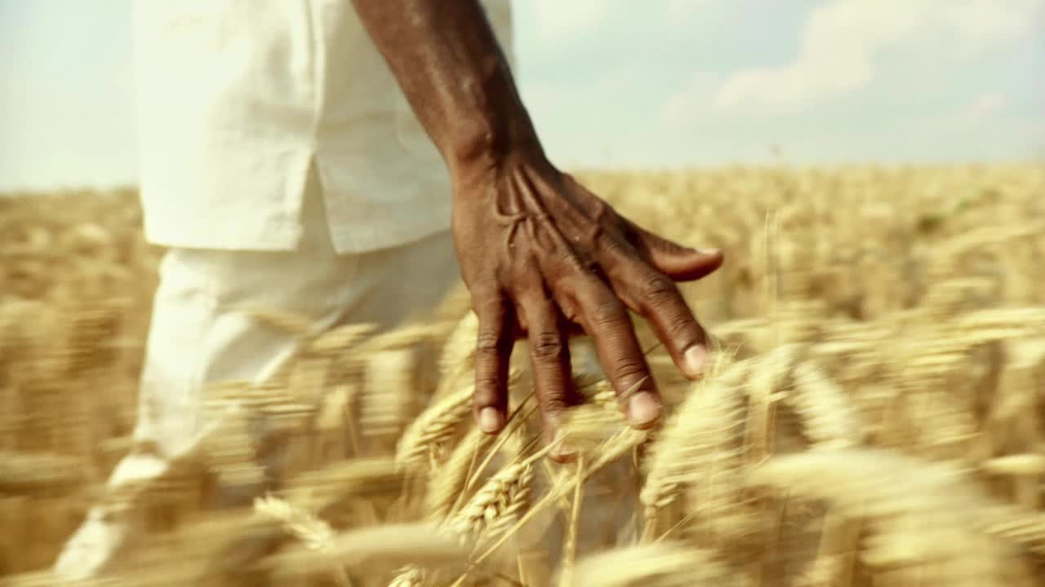
By prioritizing the mentioned strategies and next steps, India can greatly improve its crop production capabilities. Embracing advanced technologies, data-driven decision-making, and sustainable agricultural practices will reduce risks, enhance forecasting accuracy and ultimately increase yields, fostering more resilient agricultural systems. Collaboration among government agencies, research institutions, private sector stakeholders, and the market will be essential for advancing these initiatives. Leveraging future internet technologies and data analytics promises long-term agricultural sustainability and profitability for Indian farmers.

